Slide 1
Shell-Model Calculation of 100Mo Double-β Decay
Author:
L. Coraggio , N. Itaco
时 间
Reporter: Xingcan Cao

Slide 2
CONTENTS
Motivation and Background
Theoretical Framework
Results and Analysis
Summary

Slide 3

1
Motivation and Background

Slide 4
Motivation for Studying Double-β Decay
Between the late 1990s and the early 2000s, the observation that solar and atmospheric neutrinos oscillate has indicated that these elusive particles have nonzero mass.
01
Fundamental Importance of Neutrinoless Double-β Decay
02
Current Experimental Efforts and Challenges
The observation of 0νββ decay would also provide crucial information about the absolute scale of neutrino masses and their hierarchy., which are key parameters in the standard model of particle physics Neutrinoless double- β decay (0νββ) is a rare second- order electroweak process that, if observed, would demonstrate that neutrinos are Majorana particles.
and beyond.
Several experiments are currently searching for 0νββ decay of 100Mo, including AMoRE, NEMO 3, CUPID- Mo, and the future ton- scale CUPID experiment. However, the detection of 0νββ decay is extremely challenging due to the extremely long half- life of the process and the need to suppress background noise.

Slide 5

Previous Theoretical Work
Overview of Previous Models and Approaches
Limitations of Previous Shell-Model Calculations
Various nuclear structure models have been employed to study double- β decay, including the interacting boson model (IBM), quasiparticle random- phase approximation (QRPA), energy density functional (EDF) methods, covariant density functional theory, and the shell model.
Each model has its strengths and limitations. These models often rely on empirical adjustments or approximations that may limit their predictive power. For example, the IBM is well- suited for describing collective properties of nuclei, while the QRPA provides a microscopic description of the decay process.
Previous shell- model calculations for 100Mo have faced significant challenges due to the complex structure of Mo isotopes, characterized by shape coexistence and triaxiality softness.
The large number of valence nucleons involved in the decay makes the shell- model calculations computationally demanding. and requires truncation of the model space. The truncation process must be carefully designed to retain the essential physics while reducing the computational complexity. Previous studies have shown that the choice of model space and the method of truncation can significantly affect the results.

Slide 6
2
Theoretical Framework

Slide 7
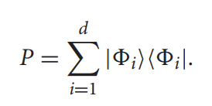
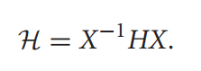
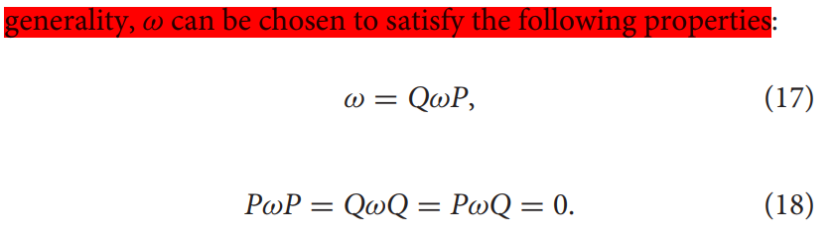
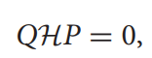
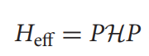
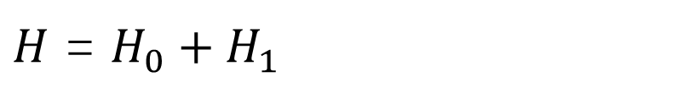
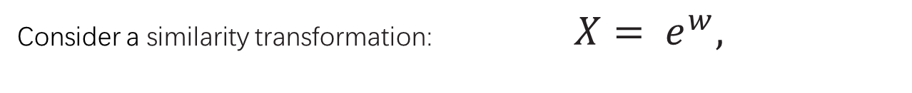
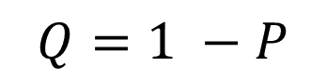
Effective Shell-Model Hamiltonian
The starting point is the high- precision CD- Bonn nucleon- nucleon (NN) potential, generate the full nuclear Hamiltonian for A interacting nucleons.
$H$ = $H_{0}+H_{1}$
Hope to expand it to a model space:
$$Q=1 −P$$
Consider a similarity transformation: $X= e^{w},$

Slide 8
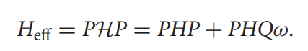
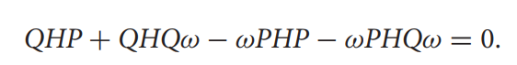
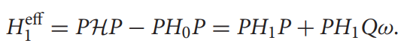
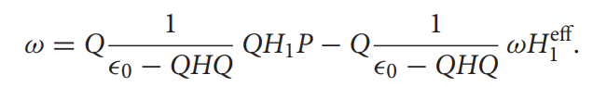
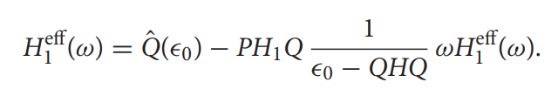
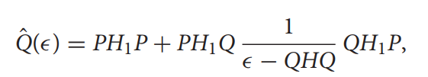
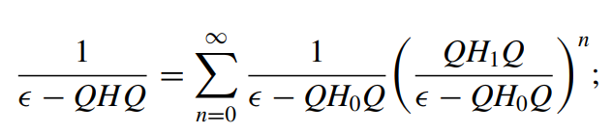
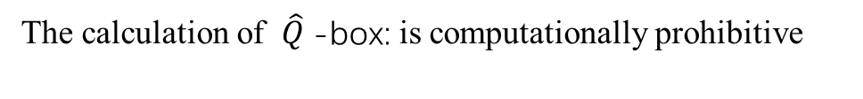
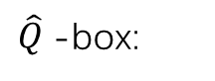
Effective Shell-Model Hamiltonian
Then, we can obtain these equations:
introduce an intermediate quantity:
We can obtain iterative equation (begin with w=0):
$\hat{Q}$-box:
The calculation of $\hat{Q}$-box: is computationally prohibitive
up to the third order

Slide 9
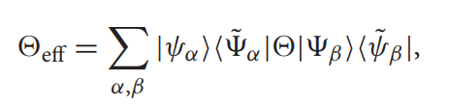
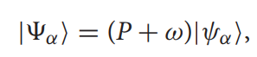
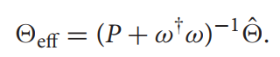
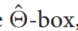
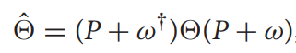
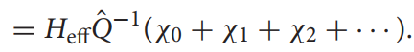
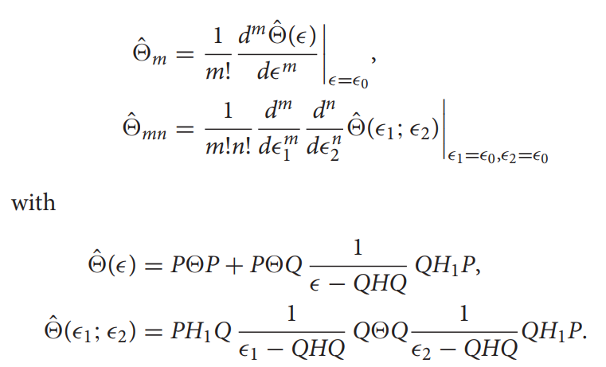
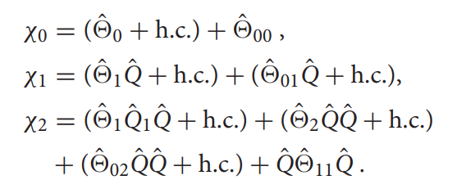
Effective Shell-Model Decay Operators
A general effective operator expression in the bra-ket representation is
using
we can obtain
where
Use w we had obtain before, we can get:
where:

Slide 10
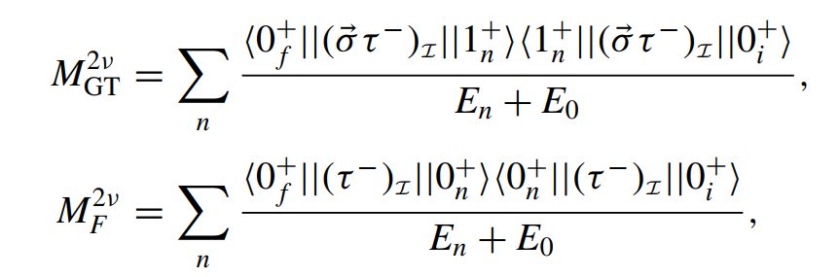
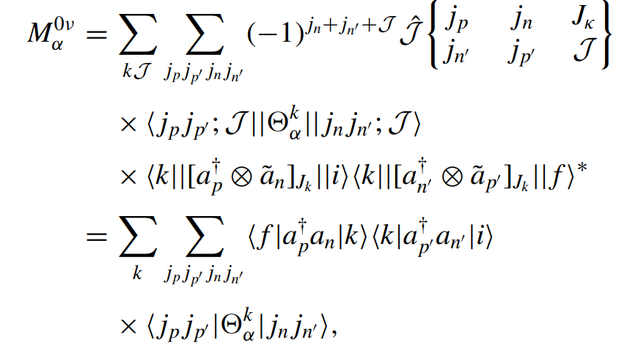
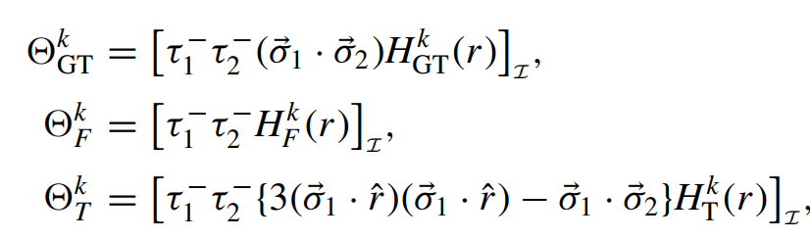
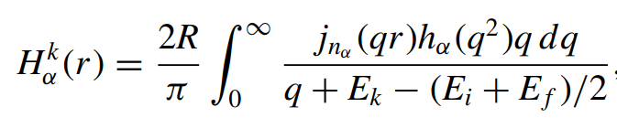
Double-β Decay Operators
where:

Slide 11
3
Results and Analysis

Slide 12
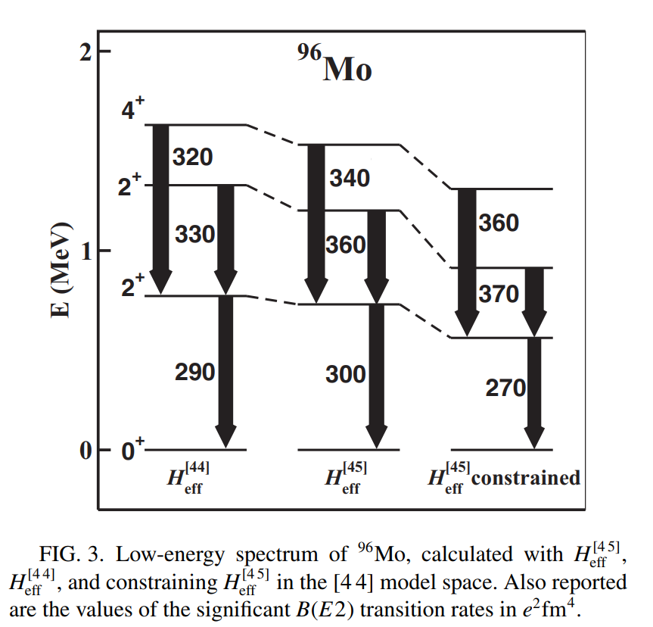
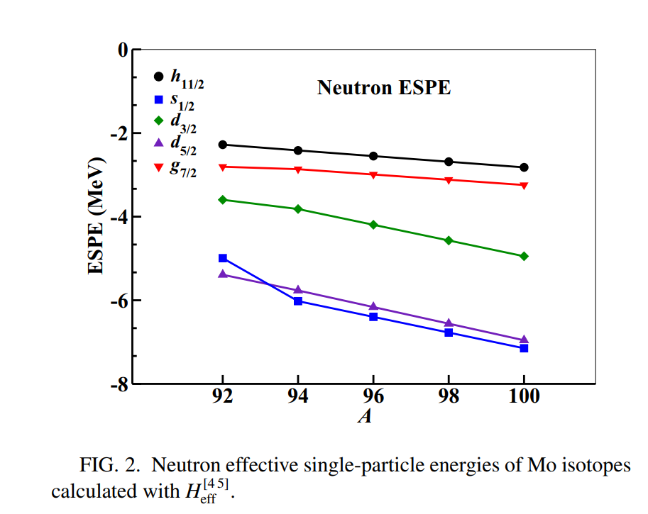
Select Model Space
four proton orbitals (0 f5/2, 1p3/2, 1p1/2, 0g9/2) and five neutron orbitals (0g7/2, 1d5/2, 1d3/2, 2s1/2, 0h11/2) outside the 78Ni core.
only consider four neutron orbitals (0g7/2, 1d5/2, 1d3/2, 2s1/2)
there is an energy gap separating the 1d5/2, 1d3/2, 2s1/2 neutron orbitals 0g7/2, 0h11/2 ones, which enlarges by increasing the number of valence neutrons.

Slide 13
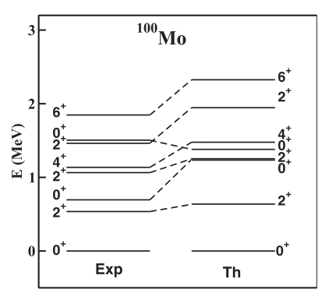
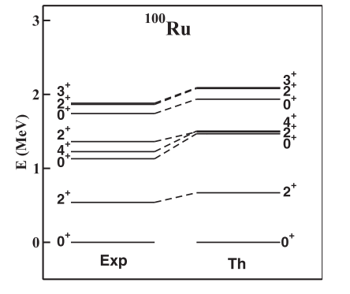
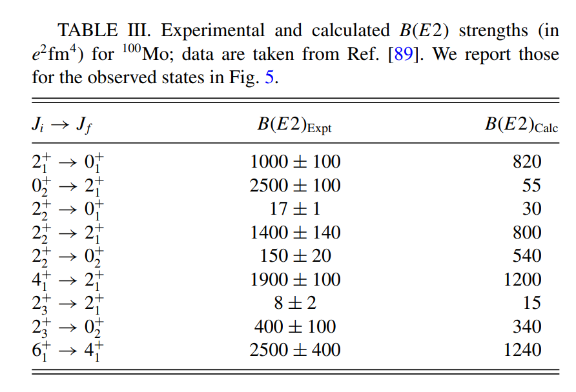
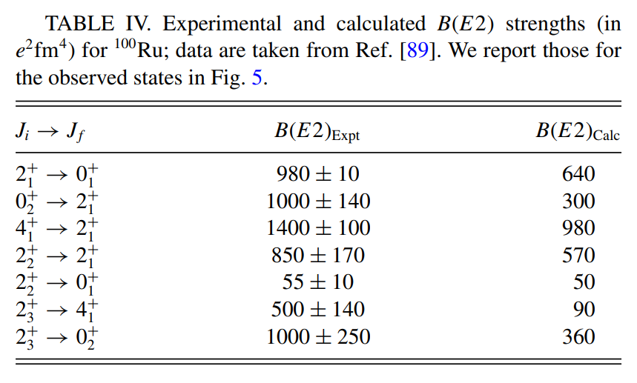
Spectroscopy of 100Mo and 100Ru

Slide 14
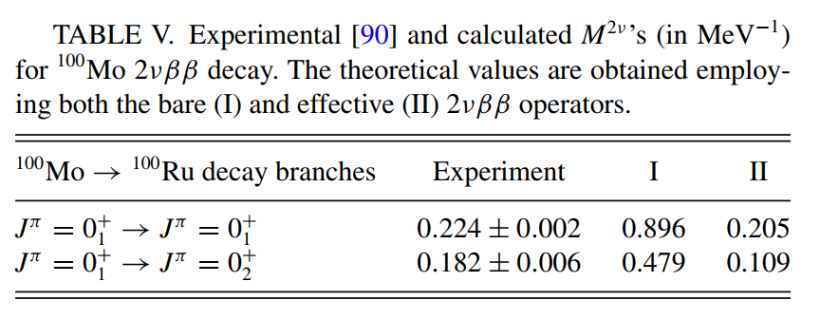
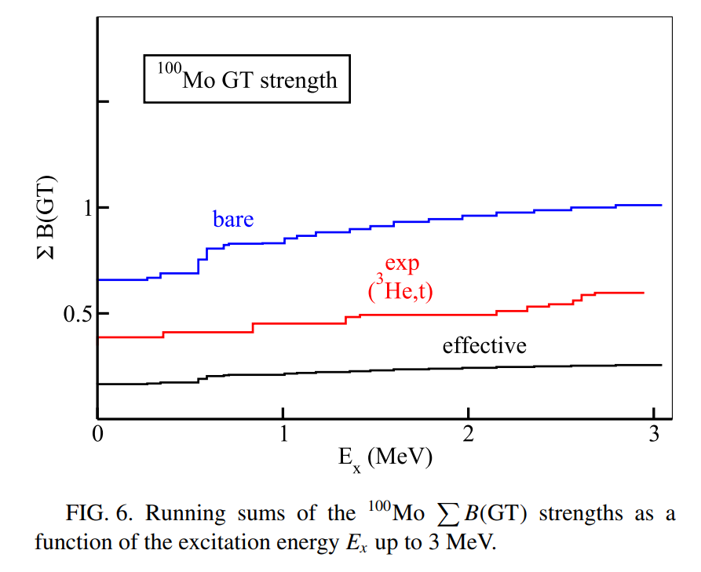
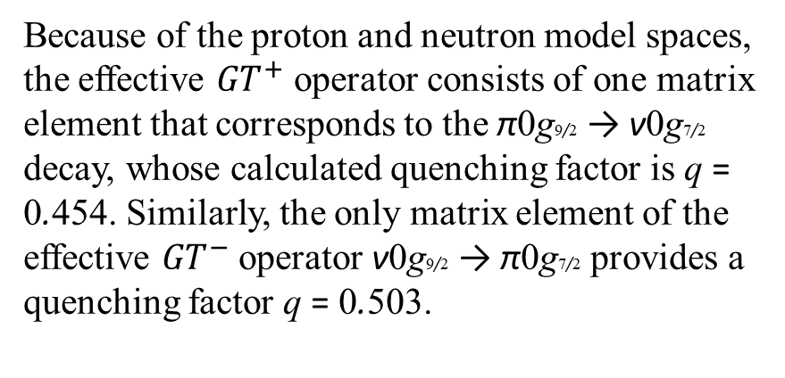
2vββ Decay
Because of the proton and neutron model spaces, the effective ${GT}^{+}$ operator consists of one matrix element that corresponds to the π0g9/2 → ν0g7/2 decay, whose calculated quenching factor is q = 0.454. Similarly, the only matrix element of the effective ${GT}^{−}$ operator ν0g9/2 → π0g7/2 provides a quenching factor q = 0.503.
It can be seen that the distribution obtained using the bare operator overestimates the observed one, but the quenching induced by the effective operator provides an underestimation of the values extracted from the experiment.

Slide 15
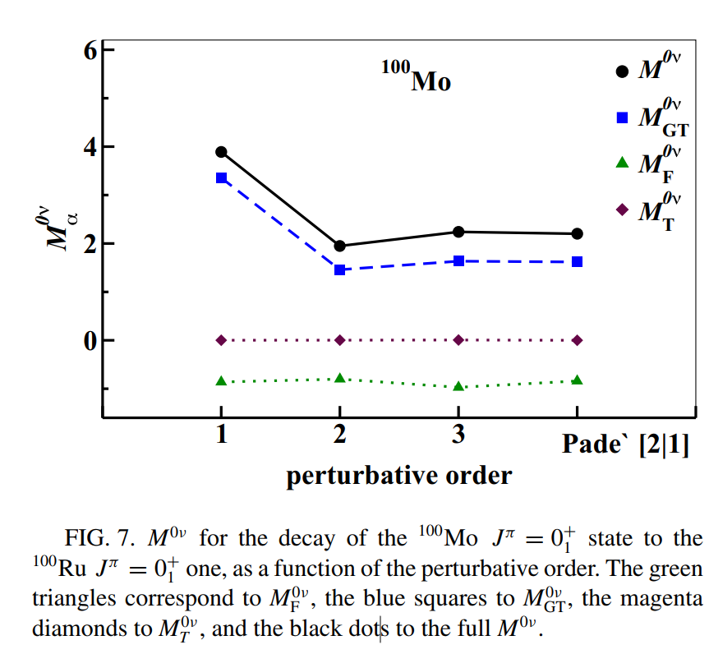
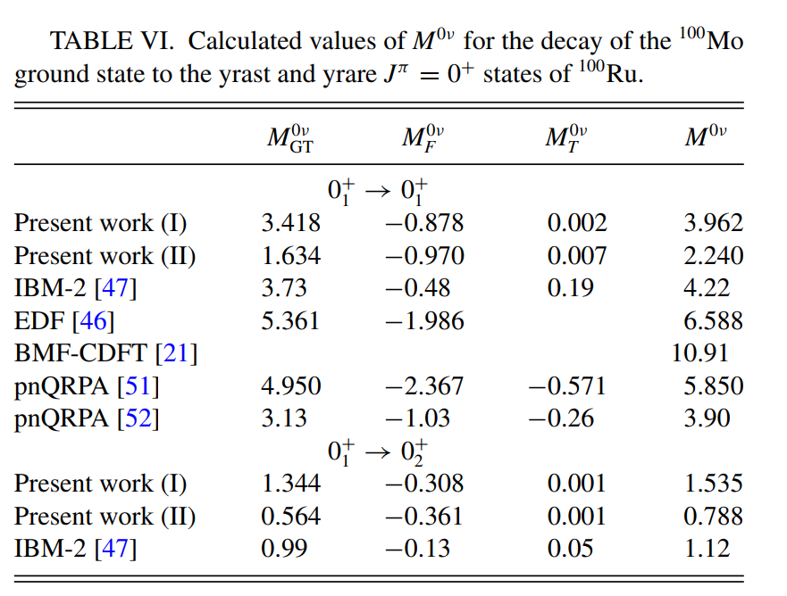
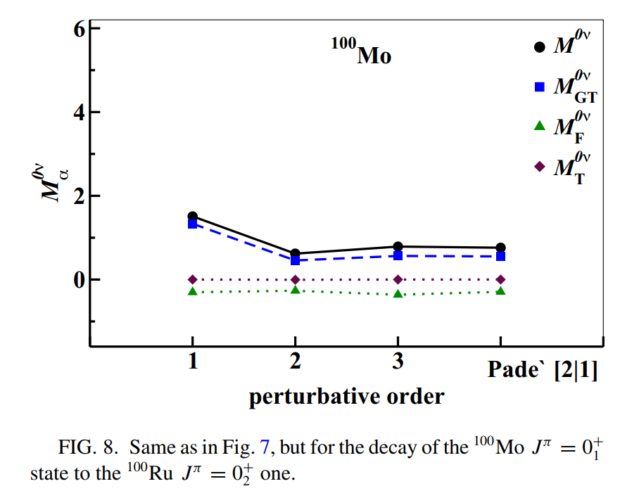
0vββ Decay

Slide 16
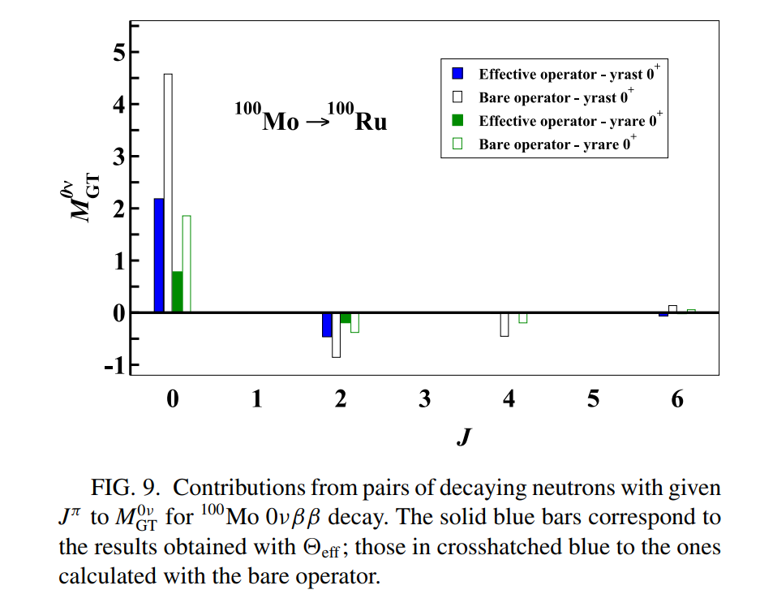
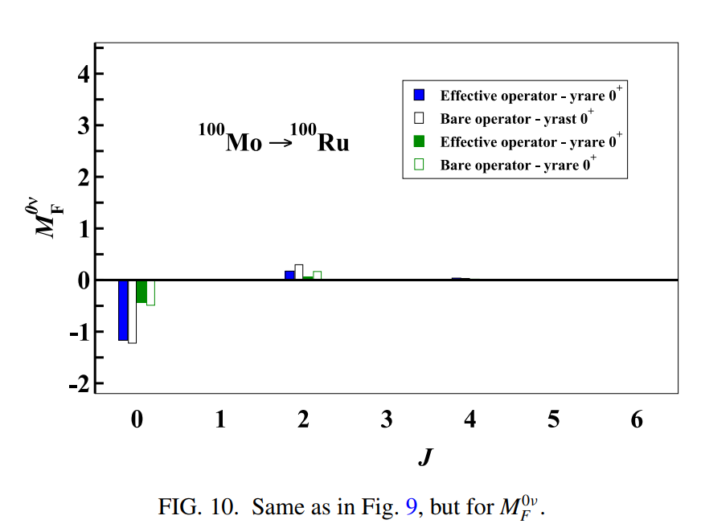
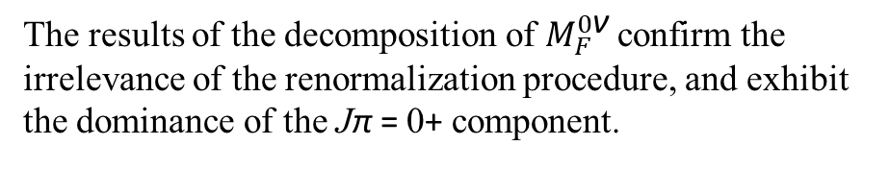
0vββ Decay
These considerations are related to the question of whether or not one should relate the derivation of the effective one-body GT operator with the renormalization of the two-body GT component of the 0νββ operator
The results of the decomposition of $M_{F}^{0\text{ν}}$ confirm the irrelevance of the renormalization procedure, and exhibit the dominance of the Jπ = 0+ component.

Slide 17
4
Summary and Future Work

Slide 18
Summary of the Study
This work presents the first shell- model calculation of the double- β decay of 100Mo, including both the two- neutrino and neutrinoless decay modes.
The effective shell- model Hamiltonian and decay operators are derived consistently from a high- precision realistic potential using many- body perturbation theory.
The calculated spectroscopic properties and decay matrix elements show good agreement with experimental data, demonstrating the reliability of the shell- model approach for describing the structure and decay properties of 100Mo and 100Ru.

Slide 19
Future Directions
01
02
The future work will focus on improving the theoretical framework by constructing effective shell- model Hamiltonians and decay operators from nuclear forces derived within the framework of chiral perturbation theory.
Larger model spaces will be explored to better account for the low- energy collective behavior of nuclei with mass A ≈ 100 and to study the dependence of the calculated NMEs on the dimension of the model space.

Slide 20
谢谢大家
汇报人
时 间

